Slide 1
Market and Customer Focus
Robyn LeBoeuf, PhD

Slide 2
Introduction:
Who am I?
What is marketing?
Course / syllabus overview
Case: Barbie
Segmentation, Targeting, and Positioning
Case: DayTwo
Marketing plan
Agenda

Slide 3
Who am I?

Slide 4
Who am I?
Robyn LeBoeuf
Professor of Marketing
Born in Louisiana
PhD, Princeton University, 2002
At WashU since 2014
Also Vice Dean of Faculty and Research

Slide 5
Who am I?
I teach:
Market and Customer Focus (EMBA)
Consumer Behavior (BSBA, MBA, PMBA)
Judgment and Decision Making (PhD)

Slide 6
Who am I?
I research:
Biases in judgment and choice
Financial decision making
Gift-giving
How people think about the future

Slide 7



Who am I?
You can find my research:

Slide 8



Who am I?
You can find my research:

Slide 9

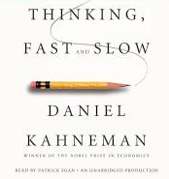

Who am I?
You can find my research:

Slide 10

Who am I?
When I’m not thinking about marketing…

Slide 11
What is Marketing?

Slide 12
What is Marketing?
When you think of marketing, what is the first word you think of?
To respond, please:
Go to PollEv.com/leboeuf
Or, text leboeuf to 22333, then text your response.

Slide 13
What is Marketing?
In well-ordered states, storekeepers and salesmen are commonly those who are weakest in bodily strength and, therefore, of little use for any purpose. --Plato

Slide 14
What is Marketing?
Merchants are to be accounted vulgar, for they can make no profit except by a certain amount of falsehood.
-- Cicero

Slide 15
What is Marketing?
Advertising…is a meretricious endeavor in which psychological appeals to “fear” and “shame” are developed to bamboozle the public into purchasing essentially worthless packaged goods at bloated prices.
--Veblen

Slide 16
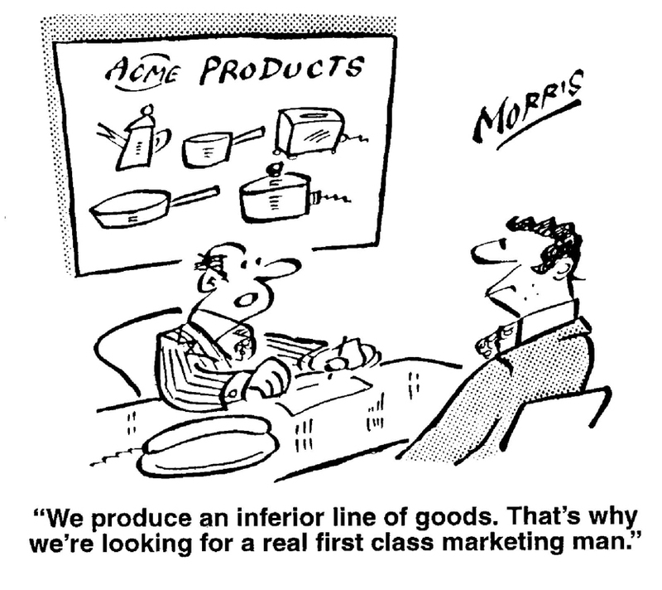
What is Marketing?

Slide 17
What is Marketing?
Corporate leaders nationwide are discovering that their most powerful competitive weapon is marketing -- the development, pricing, distribution and promotion of products.
--Newsweek

Slide 18
What is Marketing?
Marketing is now central to success at any company in any business and it’s going to make the difference between winners and losers.
--Stephen Greyser, HBS

Slide 19
What is Marketing?
More than half of the polled executives at 250 corporations ranked marketing as the most important element of strategy…
--Yankelovich, Skelly, and White

Slide 20
What is Marketing?
Marketing is the activity, set of institutions, and processes for creating, communicating, delivering, and exchanging offerings that have value for customers, clients, partners, and society at large.
--American Marketing Association

Slide 21
What is Marketing?
Marketing is a social and managerial process by which individuals and groups obtain what they need and want through creating, offering, and exchanging products of value with others.
--Philip Kotler, Kellogg

Slide 22
Marketing Analysis (The 5 C’s)
Customers
Company
Competitors
Collaborators
Context
Market
Segmentation
Target
Market
Selection
Product and
Service
Positioning
Creating
Value
Marketing Mix (The 4 P’s)
Product & Service
Place/Channels
Promotion
Capturing
Value
Pricing
Sustaining
Value
Customer
Acquisition
Customer
Retention
Profits
What is Marketing? A Framework

Slide 23
What is Marketing?
Customer needs
What needs do we seek to satisfy?
Company skills
What skills do we possess to meet those needs?
Competition
Who competes with us in meeting those needs?
Collaborators
Whom should we enlist to help us, and how do we motivate them?
Context (marketing environment)
What social-cultural, technological, political-legal, demographic, economic and natural factors limit and define what is possible?

Slide 24
What is Marketing?
Segmentation
Grouping customers along relevant (strategic or tactical) dimensions
Target market selection
Deciding which segments to pursue
Positioning
Creating a meaningful and distinct image of the offering in customer’s minds (for each targeted segment)

Slide 25
What is Marketing?
Product
Product variety, quality, design, features, brand name, packaging, sizes, services, warranties, returns
Promotions
Sales promotions, advertising, public relations, direct marketing
Place
Channels, coverage, assortments, locations, inventory
Price
List price, discounts, allowances, payment period, credit terms

Slide 26
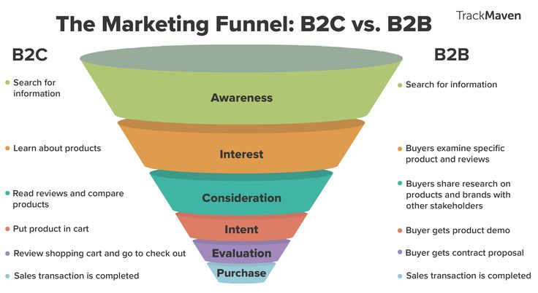
What is Marketing? The Marketing Funnel

Slide 27
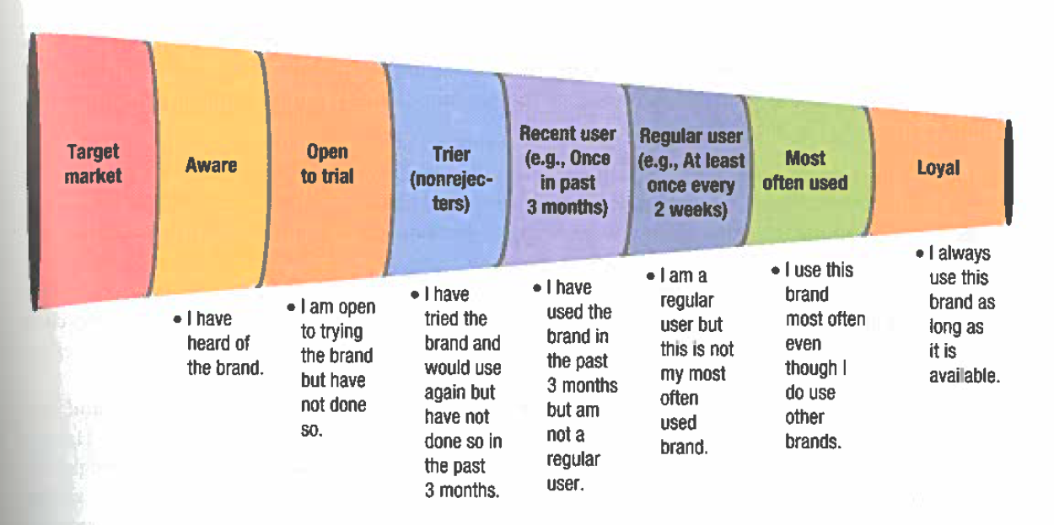
What is Marketing? The Marketing Funnel

Slide 28
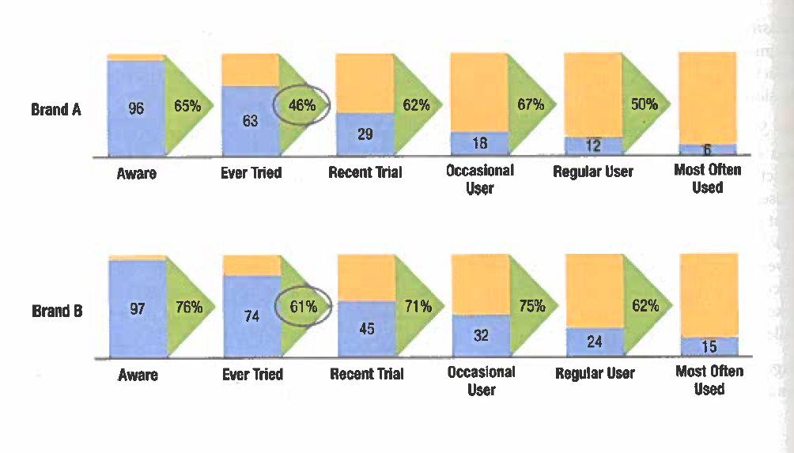
What is Marketing? The Marketing Funnel

Slide 29
Marketing Overview - Summary
Marketing involves creating, offering, and exchanging value.
Marketing frameworks and the marketing funnel can help you start to put the pieces together.

Slide 30
Course Overview and Expectations

Slide 31
Focus of This Class
How to conduct, analyze, and use marketing research to:
connect with customers
make better business decisions
be more profitable
How to analyze market segments
How to pick the best segment to target
How to effectively position your product

Slide 32
Focus of This Class
How to build and manage brand equity
How to successfully introduce new products and services
How to effectively use the 4 Ps (product, price, promotion, place) to increase profitability
How to develop and understand a marketing plan

Slide 33
Course Outline
Day 1: Connecting with your customers
What is marketing?
Segmentation, targeting, and positioning
Marketing plans
Day 2: Profiting from marketing research
Day 3: Building strong brands

Slide 34
Course Outline
Day 4: Marketing and new products
Day 5: Customer relationships and customer lifetime value
Day 6: Communicating with your customers

Slide 35
Course Expectations
Each day:
Read all assigned cases
Submit assigned case questions before class
Contribute to class discussions
Contribute to breakout assignments

Slide 36
Course Expectations
Ongoing project:
Marketing plan written report (team project)
Marketing plan presentation (team project)

Slide 37
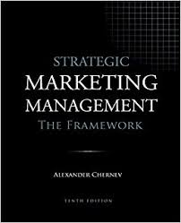
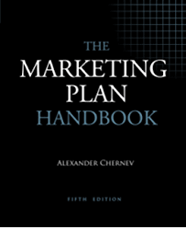
Course Expectations
Our Textbooks

Slide 38
Recurring Themes
Marketing requires being customer-centric.

Slide 39
Recurring Themes
Marketing requires both quantitative and qualitative insights.

Slide 40
Recurring Themes
Marketing frameworks are general, but marketing problems are specific.

Slide 41
Marketing Analysis (The 5 C’s)
Customers
Company
Competitors
Collaborators
Context
Market
Segmentation
Target
Market
Selection
Product and
Service
Positioning
Creating
Value
Marketing Mix (The 4 P’s)
Product & Service
Place/Channels
Promotion
Capturing
Value
Pricing
Sustaining
Value
Customer
Acquisition
Customer
Retention
Profits
Marketing Framework

Slide 42
Recurring Themes
Marketing is an investment.

Slide 43
Barbie

Slide 44
Segmentation, Targeting, Positioning

Slide 45
What is segmentation, targeting, and positioning? Why do we do it?
Segmentation
Targeting
Positioning
Segmentation, Targeting, and Positioning Agenda

Slide 46
Marketing Analysis (The 5 C’s)
Customers
Company
Competitors
Collaborators
Context
Market
Segmentation
Target
Market
Selection
Product and
Service
Positioning
Creating
Value
Marketing Mix (The 4 P’s)
Product & Service
Place/Channels
Promotion
Capturing
Value
Pricing
Sustaining
Value
Customer
Acquisition
Customer
Retention
Profits
Marketing Framework

Slide 47
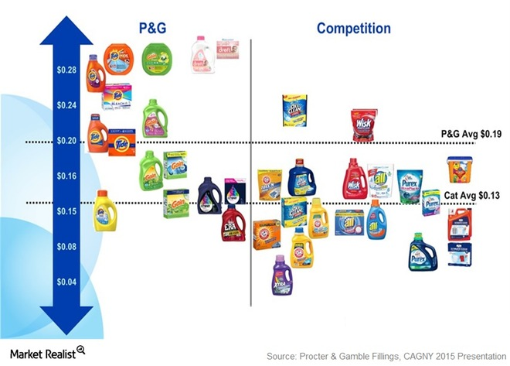
What Does Segmentation, Targeting, and Positioning Look Like?

Slide 48
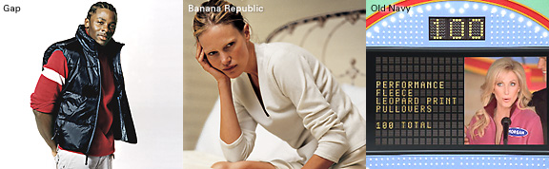

purchased in 1983
introduced in 1994
What Does Segmentation, Targeting, and Positioning Look Like?

Slide 49

What Does Segmentation, Targeting, and Positioning Look Like?

Slide 50
Marketing Analysis (The 5 C’s)
Customers
Company
Competitors
Collaborators
Context
Market
Segmentation
Target
Market
Selection
Product and
Service
Positioning
Segment the market
Develop profiles of segments
Evaluate segment attractiveness
Select target segments
Develop positioning concepts for each target segment (i.e., marketing mix: the four P’s)
Select, develop, communicate the chosen concept
Marketing Framework

Slide 51
Bases for Segmentation
Geographic “Where”
Location Climate Population Density
Demographic “Who”
Age Income Marital Status Education Profession Industry
Psychographic “Why”
Activities Interests Opinions Lifestyles Attitudes Values
Behavioral “What”
Usage Loyalty Occasions Benefits Marketing Mix Responsiveness

Slide 52

Bases for Segmentation: Benefit Segmentation

Slide 53
Bases for Segmentation
Tension between most useful and most used.

Slide 54
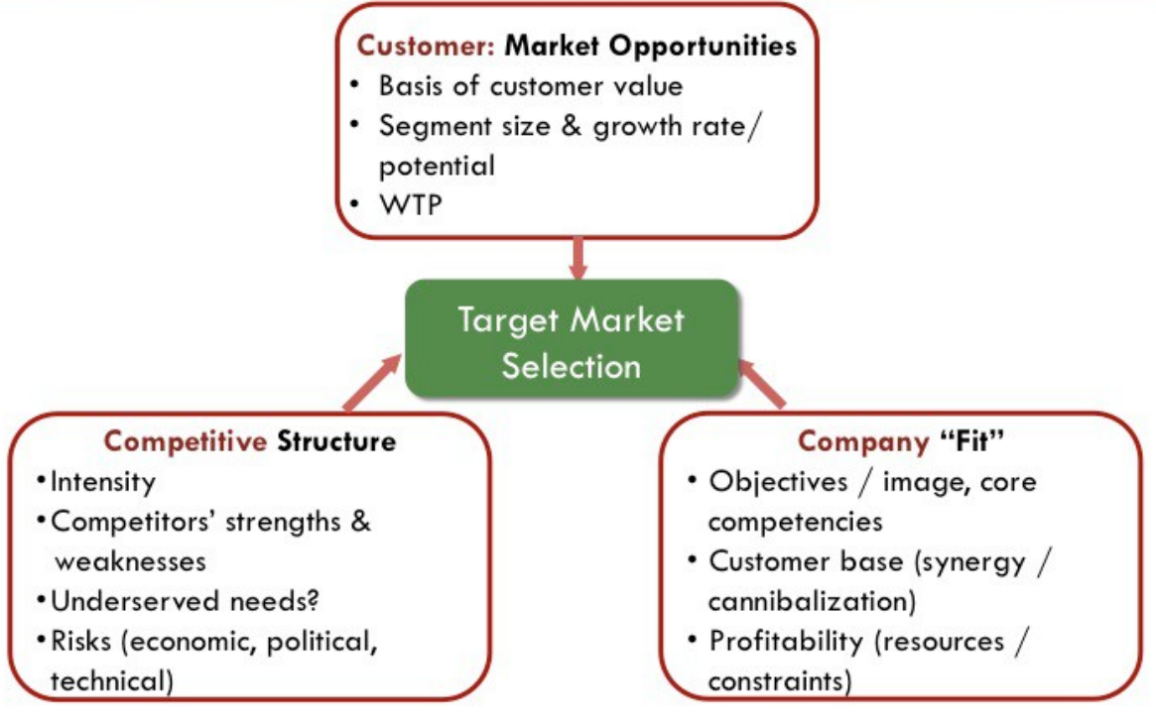
Targeting

Slide 55
Mass Marketing
Same marketing mix to all consumers
(no segmentation strategy)
Segment/Differentiated Marketing
Different marketing mixes to multiple segments
(some segmentation)
Niche Marketing
Different marketing mixes to a selective subgroup
(some segmentation)
Larger numbers (economies of scale)
Mass Customization
Suit the tastes of individuals or locations
(complete segmentation)
trade off
Level of detail
(better serving needs)
Targeting: Market Coverage Strategies
Notes:
division of market into DISTINCT GROUP OF POTENTIAL BUYERS
who have similar needs and wants

Slide 56
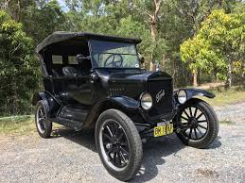
Mass Marketing

Slide 57
Differentiated Marketing
purchased in 1983
introduced in 1994
Notes:
Who else does this?
Express, ExpressMen, and Limited
Abercrombie, Abercrombie and Fitch, and Hollister

Slide 58
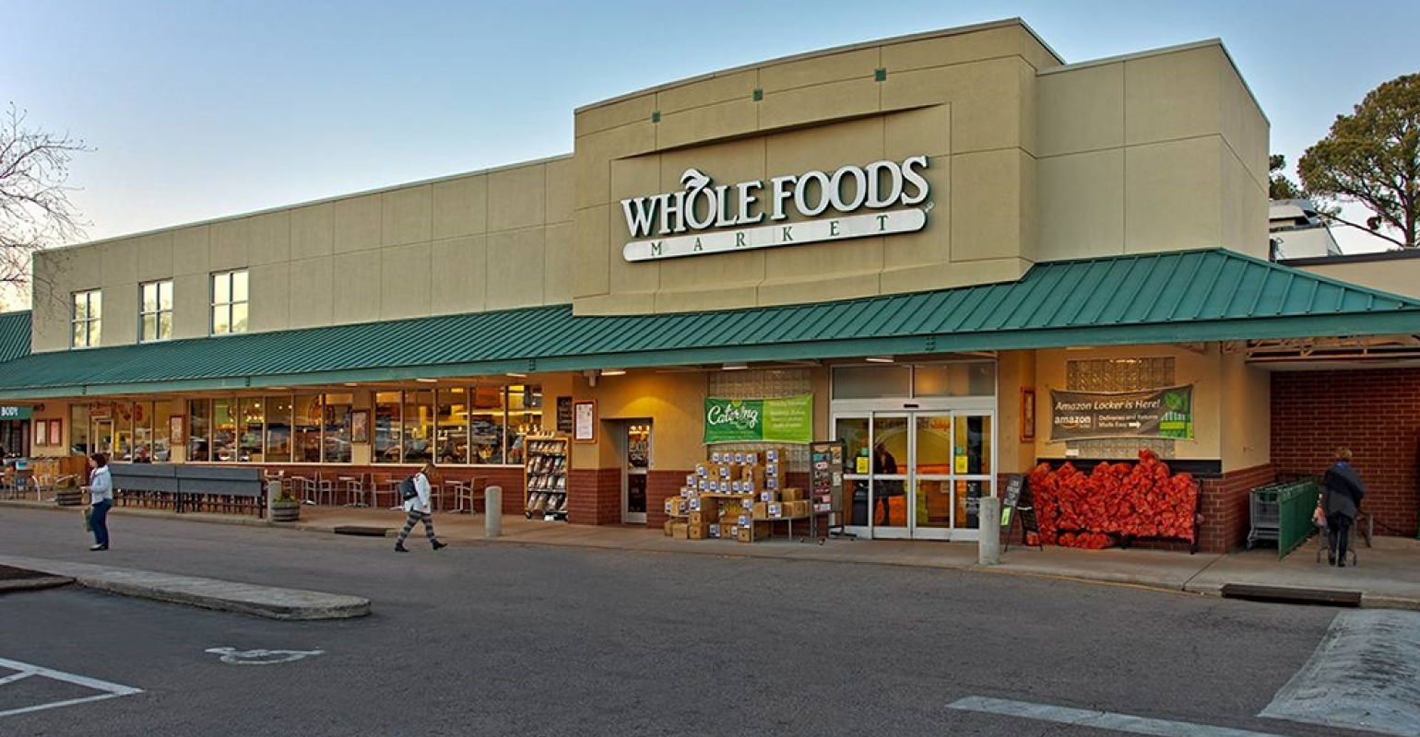
Niche Marketing

Slide 59
Positioning
Framing the brand in the target consumers’ minds so that it occupies a distinct and valued place.

Slide 60
Lexus vs. BMW
What is the difference?
Positioning

Slide 61
Positioning
Identify and choose competitive advantages
Points of parity
Points of difference
(Classic example)

Slide 62
For ____________________________________________
(target segment)
we offer ____________________________________
(single most important claim)
among all ________________________________________
(competitive frame)
because _________________________________________
(single most important support)
Positioning Statement

Slide 63
For business people who rent cars,
Avis is the company who will give you the best service
among all car rental companies
because the employees own the company.
Positioning Statement

Slide 64
Segmentation, Targeting, and Positioning Summary
The easiest segments to reach may not be the most valuable.
Consider tradeoffs between the costs of serving multiple segments and the benefits of fulfilling a segment’s needs precisely.
Ensure that your brand is positioned to convey the right value to the right people.

Slide 65
DayTwo
Website

Slide 66
Marketing Plan Assignment

Slide 67
Marketing Plan
Your assignment:
Develop a marketing plan for a new product (not something your company is already working on).

Slide 68
Marketing Plan - Deliverables
This Saturday:
Briefly tell us, in class, what product you’ll focus on (nothing formal turned in) .
Last day of class:
Written marketing plan (25 pp. max)
Presentation to class (~10-15 min.)

Slide 69
Marketing Plan
Ok… but what is a marketing plan?
Written document
Summarizes what the marketer has learned about the marketplace
Indicates how the firm plans to reach its marketing objectives

Slide 70
Marketing Plan
Some ideas from previous classes
Home beekeeping kits
Digital platform connecting craft brewers to customers
Stroller handle extender
After-school transportation for kids

Slide 71
Marketing Plan
The Marketing Plan Handbook
Chapters 1-3: information on writing a plan
Chapters 5-7: some examples
Appendix B: how to write a positioning statement
Appendix D: how to develop a communication plan

Slide 72
Marketing Plan
Executive summary
2. Situation overview
Identify relevant opportunities and threats
3. What is your goal?
Primary goal
Market objectives
Key pieces of the marketing plan that must be achieved to reach the primary goal

Slide 73
Marketing Plan
4. Marketing strategy
Target market
Customers
Collaborators
Company (if relevant)
Competitors (Many plans underestimate this. Think broadly. Get detailed.)
Context
Value propositions
Customer value proposition
Collaborator value proposition
Company value proposition (if relevant)
*Think about your positioning statement!

Slide 74
Marketing Plan
5. Tactics (How to achieve your goals)
Product
Service (Product)
Brand (Product)
Price
Incentives (Promotions)
Communications (Promotions)
Distribution (Place)
6. Implementation (you don’t need to do this)
7. Control (you don’t need to do this)

Slide 75
Marketing Plan
Marketing research is important.
Test your idea?
Get general customer interests?
Briefly describe the focus of your plan on January 18.
Written plans and presentations are due March 15.

